Slide 1
Chapter 8
Strategies for Marketing, Sales, and Promotion
Electronic Commerce

Slide 2
Objectives
Establishing an effective business presence on the Web
Web promotion techniques
Meeting the needs of web site visitors
Web site design usability testing
Identifying and reaching customers on the web

Slide 3
Objectives
Effective Web marketing approaches
Elements, strategies, and costs of branding
Web business models for selling

Slide 4
Creating an Effective
Web Presence
Presence
  Public image it conveys to stakeholders
Stakeholders
  Include customers, suppliers, employees, stockholders, neighbors, and the general public
Internet increases importance of presence
  Only contact a customer might have with company is with the company web site
  Can be critical even for the smallest and newest company

Slide 5
Identifying Web
Presence Goals
A firm’s physical location rarely is image-driven
  Physical location must satisfy many other business goals unrelated to image and presence
  Web sites can perform many image-enhancing tasks effectively
  Businesses must decide which tasks their Web site must accomplish and which tasks are the most important to include

Slide 6
Achieving Web
Presence Goals
Goals associated with effective web sites include:
  Attracting visitors
  Making the site interesting to explore
  Creating a positive image consistent with the company’s desires
  Reinforcing already held positive images regarding the company

Slide 7
How the Web is Different
Companies early in Web history failed to recognize what visitors wanted from Web sites
  Often failed to include e-mail addresses or adequate staffing to answer customers’ e-mail messages
Web presence should include:
  History
  Mission statement
  Financial and product information
  Method of contacting the organization

Slide 8
Meeting the Needs of
Web Site Visitors
Why visitors come to Web sites
  To learn about or buy a company’s products or services
  Get product support for products already bought
  Obtain financial or general product information about a company
  Communicate with the company or identify who manages it

Slide 9
Meeting the Needs of
Web Site Visitors
Web site interface flexibility
  Versions with and without frames, graphics
  Multiple information formats
  Allows users to easily access multiple levels of information detail

Slide 10
Usability Testing
How users navigate through a series of web site test designs
T. Rowe Price redesigned their web site so no more than 2 page clicks were required to get to desired information

Slide 11
Usability Hints
Design the site around how visitors navigate, rather than around the company’s organizational structure
Allow quick information access
Avoid exaggerated marketing claims

Slide 12
Usability Hints
Build a site using the oldest browser software on the oldest computer, using the slowest connection, even if that means making multiple versions
Be consistent and clear with design and navigation controls
Test text and color combinations

Slide 13
Nature of Communication on the Web
Two methods of reaching customers:
  Personal contact model
    Also called prospecting
    Firm’s employees individually search for, qualify, and contact potential customers
  Mass media model
    Firm delivers message and broadcasts it through billboards, newspaper, television, etc.
    Addressable media is sometimes distinguished from mass media
      Addressable media is directed to known addresses, and includes direct mail, telephone calls, and e-mail

Slide 14
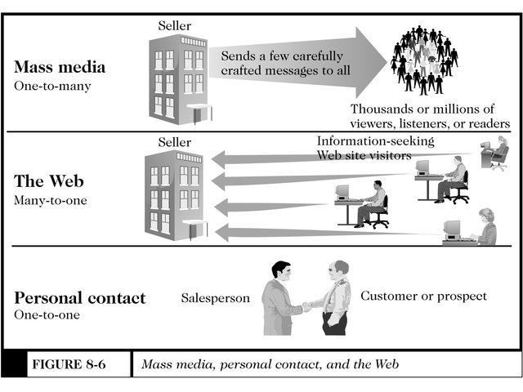
Mass Media, Personal Contact, and the Web
Figure 8-6

Slide 15
Measuring Web Site Effectiveness
Different from measuring mass media
  Mass media effectiveness determined by estimates of audience size, called cost per thousand (CPM)
    CPM is a dollar amount for each thousand people in the estimated audience

Slide 16
Web Terms Used in Marketing
A Visit occurs when a visitor requests a page from a web
  Further page loads counted as part of the visit for a time period chosen by the site administrator
Trial visit
  First time a visitor loads a web site- after that, it is called a repeat visit
Page view
  Each time a visitor loads a page- if the page has an ad, this is called an ad view
Impression -- each time a banner ad loads
  If a visitor clicks the ad to open it, it is called a click or click-through

Slide 17
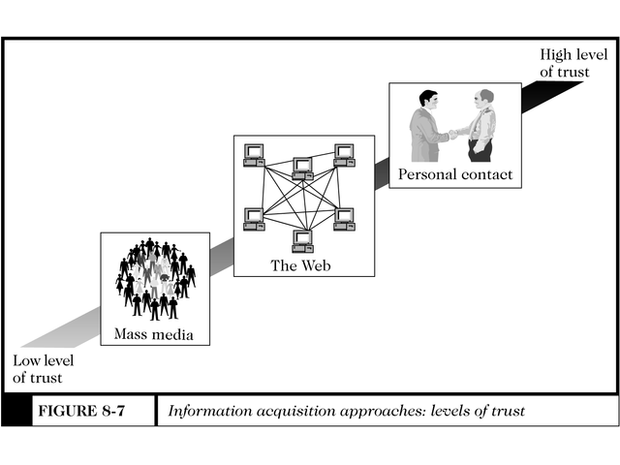
Information Acquisition Approaches: Levels of Trust
Figure 8-7

Slide 18
New Marketing Approaches for the Web
Traditional mass-market advertising has decreased in effectiveness
  Advertisers respond through market segmentation
    Divides the pool of potential customers into common demographic characteristics, such as age, gender, income level, etc. called segments
    Targets specific messages to these groups
    Micromarketing- targeting very small market segments

Slide 19
Technology-Enabled Relationship Management
Occurs when a firm obtains detailed information about a customer’s behavior, preferences, needs, and buying patterns and uses that information to customize its relationship with that customer
  Can use this information to set prices, determine needs and desires, and negotiate terms

Slide 20
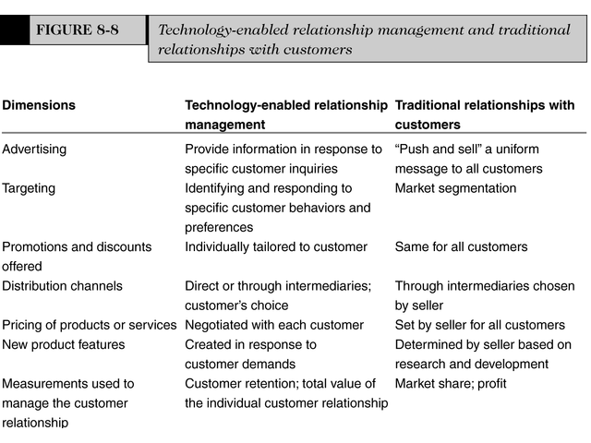
Customer Relationship Management
Figure 8-8

Slide 21
Creating and Maintaining Brands on the Web
Elements of branding
  Differentiation
  Relevance
    Degree the product offers utility to the customer
  Perceived value

Slide 22
Emotional vs. Rational Branding
Emotional appeals work well in mass media because ad targets are passive
  Do not work well on Web, however, because Web is active medium
Rational branding
  Gives people valuable service in exchange for viewing ads
    Examples include free e-mail and secure shopping services

Slide 23
Other Web
Marketing Methods
Market leaders can take their dominant positions and extend them to other products and services
Affiliate marketing
  Web site gives product reviews, description, or other information on a product for sale on another site
  Affiliate site gets commission and has no risk

Slide 24
Advertising-Supported Model
Used by network television to provide free programming
Problems with this method on the Web:
  No consensus on how to measure audiences
  Very few web sites have sufficient visitors to attract large advertisers

Slide 25
Other Market Models on the Web
Advertising-subscription mixed model
  Revenue derived from fee and it also accepts some level of advertising
  Used by newspapers and magazines
  Successful web models include New York Times, the Wall Street Journal, ESPN, Reuters, and Northern Light
Fee for transaction Model
  Online travel agents and car-buying services can remove an intermediary from a value chain
    Called disintermediation

